Slide 1
DATA MIGRATION STRATEGY

Slide 2

Migration Approach
Migrate Big Bang
01
Migrate by Market
02
Migrate by Client
03
Migrate by Product
04

Slide 3

THINGS TO CONSIDER
CRMZ readiness : Gaps that have been identified from Samsung and Home Credit implementations.
Data to migrate : Only active policies. Only open claims and closed claims within 3 months
Creating Product configuration for each Product.
Data cleansing : Removing duplicate data
Data building : Data not available that will have to be populated before migrating

Slide 4
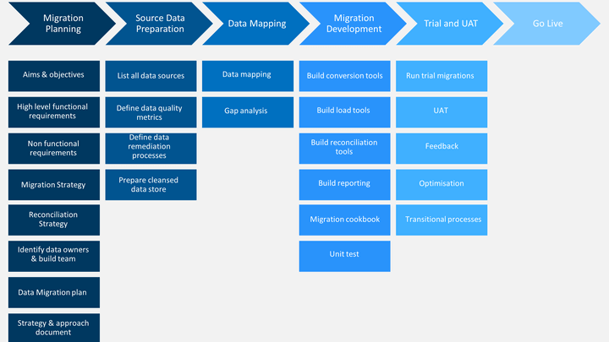
Migration Plan
MIGRATION PLAN

